Slide 1
Business Economics: Topic 1
Marcelo Ortiz M.
Department of Economics and Business
Universitat Pompeu Fabra

Slide 2
Topic 1: Human Behavior and Economic Rationality
Objectives:
Describe the economic model of behavior
Apply marginal analysis in managerial decisions
Apply the concept of opportunity cost
Describe decision-making under uncertainty
Contrast the implications of the economic model with those from other behavioral models used by managers

Slide 3
Why we need a model of economic behavior?
Managers’ responses to challenges and problems depend on their understanding of (1) people’s motives and (2) their forecast of people’s reactions.
Therefore managers’ responses rely on their (underlying) model of behavior.
Managers with different understandings (models) of what motivates behavior are likely to take different actions to face the same challenge/problem.

Slide 4
Economic model of behavior
Main ingredients:
Unlimited wants
  Material items: wealth, assets
  Time/leisure activities
  Intangibles: reputation, affection, religion, status
Limited resources
  Limited income that precluded all the purchases
  Limited resources (land, rivers, 24hrs per day)

Slide 5
Economic model of behavior: The economic choice
Model: individuals assign priorities to their wants (alternatives) and choose their most preferred options from the available alternatives
  In economics, we do not assert that people are selfish (caring only about their own personal consumption). People will behave altruistically as much as this provides them greater personal satisfaction than the alternatives
  Additionally, we do not assert that individuals are supercomputers: Imperfect knowledge and bounded rationality (cognitive limitations in storing, processing and communicating information). We assume people do the best they can to pick the alternative that increases their satisfaction

Slide 6
Economic model of behavior: The economic choice
Describe the economic choice problem behind the following cases. Explain (1) wants/alternatives (2) resources (3) preferences (4) Information limit/bounded rationality
  A client ordering a meal at McDonald
  A Manager deciding the list of products in the menu

Slide 7
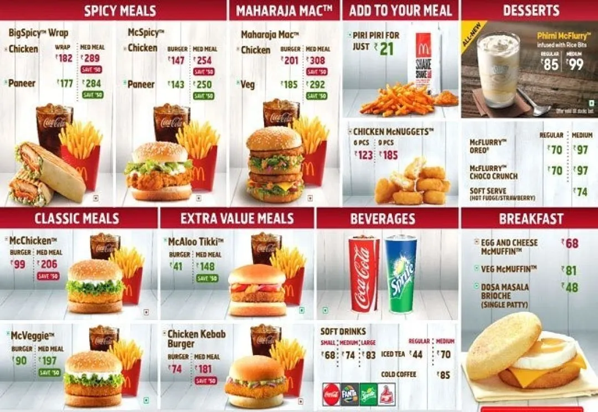
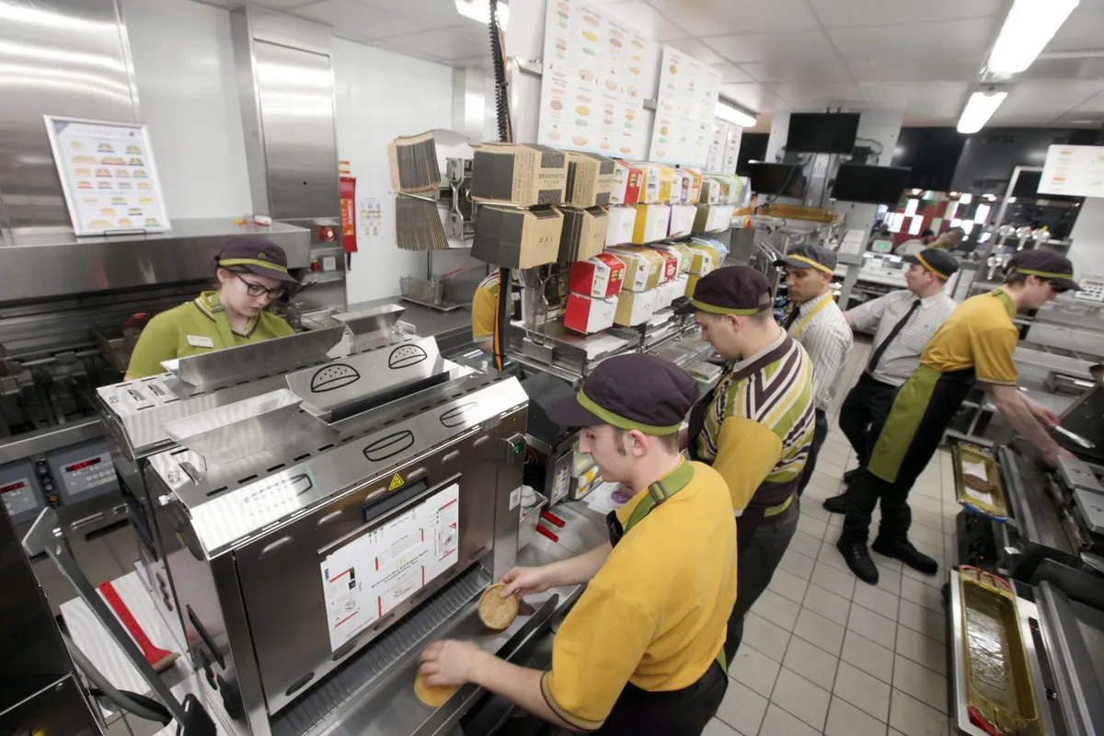
Economic model of behavior: The economic choice

Slide 8
Economic model of behavior: Marginal Analysis
Marginal costs and benefits are the incremental costs and benefits that are associated with making a decision
A decision should be taken whenever the incremental benefits of that action exceed its incremental cost
The focus on “increment/marginal” changes in benefits and cost is a cornerstone in economic analysis
  Sunk costs and benefits are irrelevant for a current economic decision

Slide 9
Economic model of behavior: Marginal Analysis
Describe the marginal analysis behind the following case. Explain (1) wants/alternatives (2) resources (3) marginal costs and benefits (4) sunk cost and benefits
  Car Systems Limited installs GPS tracking systems on trucks and cars. They received an offer of $20.000 to install GPS tracking devices for a mining company. The cost of labor and other materials is $15.000. They already have the GPS devices in stock (historical cost $2.000). The same devices are currently priced at $6.000 in the market.
  Should they accept the offer?

Slide 10
Economic model of behavior: Opportunity costs
Resources are limited, how do we use them?
The opportunity cost of using a resource for a given purpose is its value in its best alternative use
  Difficulty: most relevant economic decisions in management involve multiples resources: time, capital, assets
  Opportunity costs must be incorporated into the marginal cost
Marginal analysis frequently involves a careful consideration of the relevant opportunity costs
  Recall, implicit costs are as relevant as explicit cost
    Implicit cost: decide about breaching a contract and reputational damage; decide about accepting a job offer and the reduced time for leisure activities
  Sunk costs are not relevant in the marginal analysis because they are not affected by choices
    Sunk cost: contract breaching and previous payments; new job offer and time spent on the job applications

Slide 11
Economic model of behavior: Opportunity costs
Describe the opportunity costs behind the following cases. Explain the best alternative use of the resource(s), considering implicit and explicit costs
  1) an entrepreneur deciding to hire a manager for taking care of the current project and move forward to the next one (resource: the value of time)
  2) a soccer player deciding to accept the offer to play in another country with a better league/salary but a different language (resource: the value of time)
  3) a borrower considering not paying a bank credit (resource: personal wealth/saving)
  4) a bakery manager deciding to dismiss one the bakers who is getting blind (resource: money spent on salaries)

Slide 12

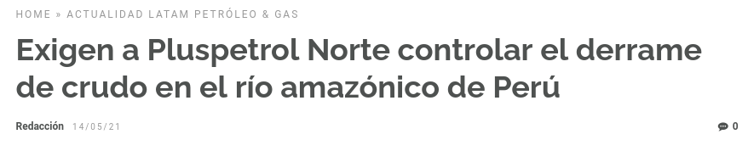
Economic model of behavior
Discuss:
1) decision-maker
2) limited resource(s)
3) alternatives uses
4) marginal analysis
5) opportunity costs (implicit and explicit)

Slide 13
Economic model of behavior: Managerial implications
So far we have seen the economic choice model
The same analysis can be used to address management problems.
Managers are interested in affecting the behavior of individuals such as employees, customers, union leaders, or subcontractors.
Economic approach: actions are the outcome of people’s economic choices – personal utility maximization
  This approach implies that if we affect the opportunities that individuals face, we also affect their choices/actions
  How do you change employees’ opportunities? ex: salaries… what else?
  How do you change customers opportunities? ex: pricing… what else?

Slide 14
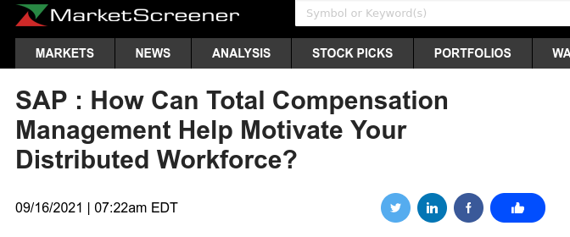
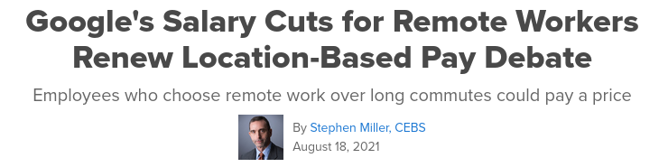
Economic model of behavior: Managerial implications

Slide 15
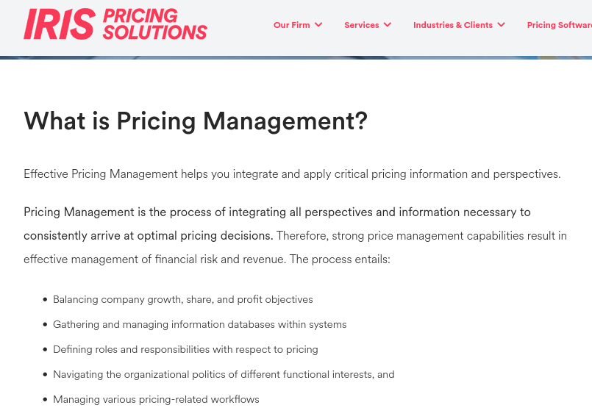
Economic model of behavior: Managerial implications

Slide 16
Economic model of behavior: Managerial implications
The outcome in economic choices also depends on individual preferences: “individuals try to achieve their highest level of satisfaction given the constraints they face”
However, in business economics we focus more on the opportunities/constraints, not the preferences. Why?
How do we change people’s tastes?
How do we observe/measure people’s tastes?

Slide 17
Economic model of behavior: Managerial implications
Important: changes in opportunities/incentives affect employee behavior, but not always in an intended manner
  Example: URSS and incentive compensation to discourage taxi drivers from simply parking their cabs
The economic model of behavior is limited in its ability to forecast precise choices of a given individuals (limitation: hidden and dynamic preferences and cognitive capacities)
Instead, the focus is on aggregate behavior or on what a typical person tends to do

Slide 18
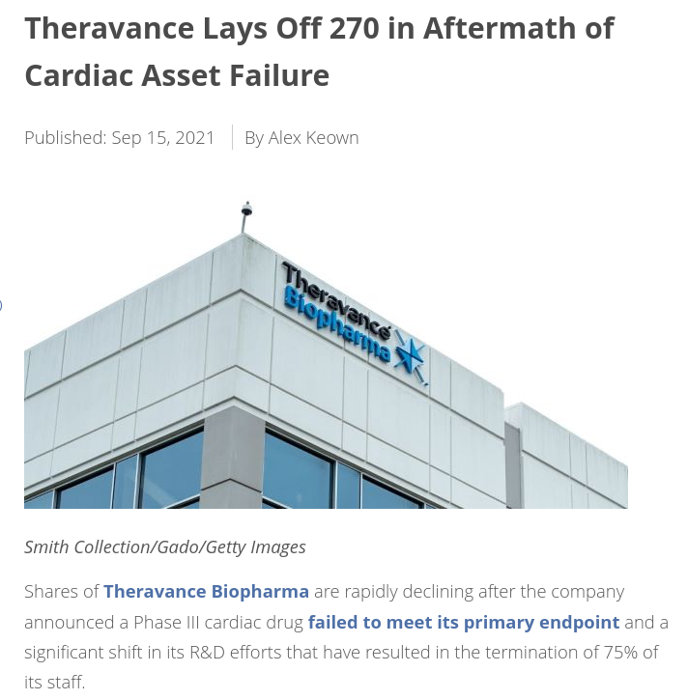
Economic model of behavior: Uncertainty
Most of the managerial decisions involve alternatives with uncertain outcomes
Case: R&D investment

Slide 19
Economic model of behavior: Uncertainty
Other cases: hiring new employees, incorporating new productive technologies.
  Indicate the decision, the outcome, and the risks related

Slide 20
Economic model of behavior: Uncertainty
We need to incorporate new concepts/tools to deal with the uncertainty behind of this type of decision
Expected value: E[payoff]= Sum(Payoff_i x ProbState_i)
Variability: V[payoff]= E[payoff^2]-E[payoff]^2

Slide 21
Economic model of behavior: Uncertainty
Risk Aversion: an individual is considered risk-averse if prefers a lower standard deviation in the payoffs when holding the expected payoff fixed
  Therefore, an individual's utility gain comes from an increase in the expected value
Risk neutral: a risk-neutral person cares only about the expected value and is indifferent to the amount of risk
Certainty Equivalent and Risk Premium:
  Suppose two wage schemes: (1) fixed salary ($80.000) (2) risky commission scheme (expected value = $100.000)
  If someone is indifferent between both options, then the fixed salary is the certainty equivalent for the risky scheme. The difference between both, $20.000, is called the risk premium which a risky scheme must include to keep the employee indifferent between both options

Slide 22
Economic model of behavior: Uncertainty
Risk aversion and employees’ compensation
  How much diversified is the wealth of shareholders?
  How much diversified is the wealth of a CEO?
  Who has more reasons to be risk-averse?
  Does this lead to a conflict of objectives? How to solve it?

Slide 23
Alternative Models of behavior
Some management problems require considering specific individual’s characteristics, for example, hiring a new CEO for the next stage of firm’s development.
  Psychological attributes are candidate-specific
  Past experiences
  Social capital/network
It’s important to recognize the limitation of the economic approach. Although it has been proved useful, other disciplines, such as psychology and sociology, complement or even improve the analysis of behavior.

Slide 24
Summary
Main concepts:
  Economic choice/problem
  Knowledge and bounded rationality
  Marginal and sunk costs/benefits
  Opportunity cost
  Risk aversion

